Slide 1
World Happiness

Slide 2
World Happiness
The World Happiness Report is a survey of the state of global happiness that ranks 156 countries by how happy their citizens perceive themselves to be.
Happiness scores and rankings use data from the Gallup World Poll
The columns following the happiness score estimate the extent to which each of six factors – economic production, social support, life expectancy, freedom, absence of corruption, and generosity– contribute to making life evaluations higher
The variables used reflect what has been broadly found in the research literature to be important in explaining national-level differences in life evaluations.
Notes:
2020 report just came out on March 20th. US at 19th

Slide 3
World BANK
The World Bank Group is a global partnership: five institutions working for sustainable solutions that reduce poverty and build shared prosperity in developing countries.
To end extreme poverty by reducing the share of the global population that lives in extreme poverty to 3 percent by 2030.
To promote shared prosperity by increasing the incomes of the poorest 40 percent of people in every country.
Notes:
Admirable goals, especially since my only goal lately is to at least get a C on this

Slide 4
World Happiness
Criticism
The surveys depend on subjective self-reporting
Too dependent on economic factors
High income improves evaluation of life but not emotional well-being
Proceedings of the National Academy of Sciences September 21, 2010
Cultural differences:
‘Happiness Report’ Uses Western Thinking to Measure Japan
Japan Forward - May 18th 2019
Or, as The New York Post puts it:
“In Scandinavia … there is immense societal pressure to tell everyone how happy you are, right up to the moment when you’re sticking your head in the oven.”
March 22nd 2017 N.Y Post https://nypost.com/2017/03/22/that-world-happiness-survey-is-complete-crap/
Notes:
Because the NY Post does have a way with words

Slide 5
World Happiness
Since the Happiness report utilizes two “hard” categories (economic production and life expectancy) are these consistent with economic indicators from the World Bank?
If so, what else might the Happiness Rankings tell us about other economic and social data from the World Bank?
Notes:
I’m really not interested in individual countries rankings and the fact that economic basis gives me something to work with
Looking at 2017 because there is good data for that year in the World Bank

Slide 6
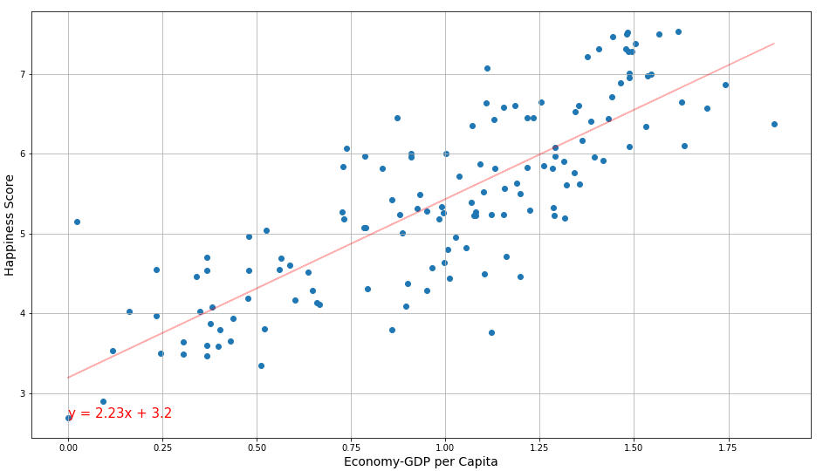
World Happiness Happiness score vs. GDP Per Capita
The r-squared is: 0.823
Happiness Score
Vs.
GDP per Capita
Happiness increases as GDP increases
Source: World Happiness Report - 2017
Notes:
Looking at Just the Happiness report itself we see that Happiness and GDP are very strongly correlated
Money can buy happiness, at least on a country wide scale

Slide 7
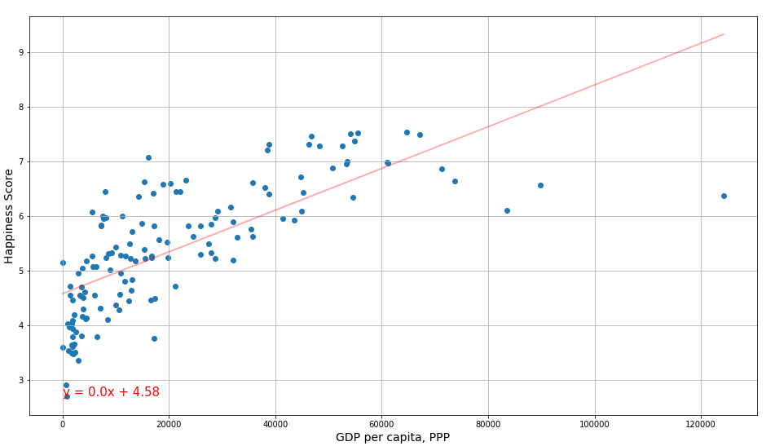
World Happiness Happiness score vs. World Bank GDP Per Capita
The r-squared is: 0.724
Happiness Score
Vs.
GDP per Capita (W.B)
Source: World Happiness Report –2017 & World Bank World Development Indicators - 2017
Notes:
While the scatter plots don’t look the same (bunching at the middle of happiness)
We still have the same very strong positive correlation

Slide 8
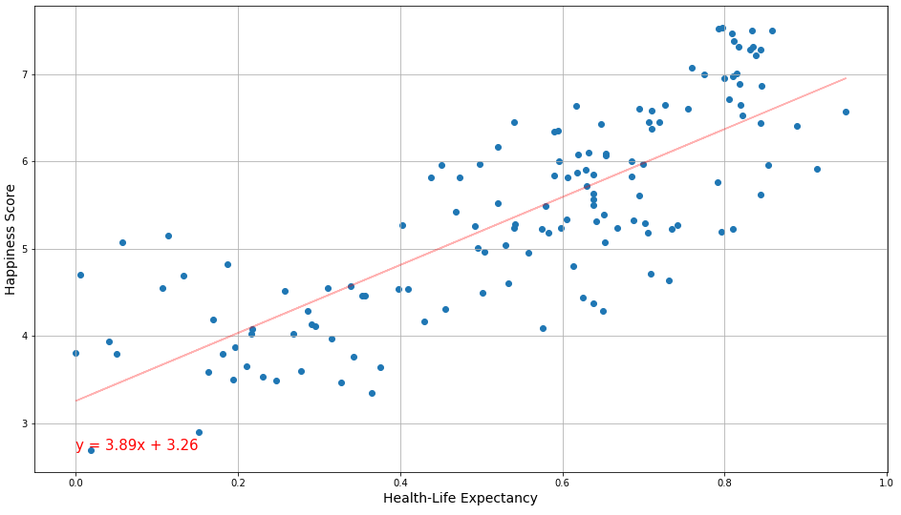
World Happiness Happiness score vs. Life Expectancy
The r-squared is: 0.797
Happiness Score
Vs.
Life Expectancy
Source: World Happiness Report - 2017
Notes:
Again just in the happiness report itself there is a very strong positive correlation between Happiness score and Live expectancy
Money can buy happiness, at least on a country wide scale

Slide 9
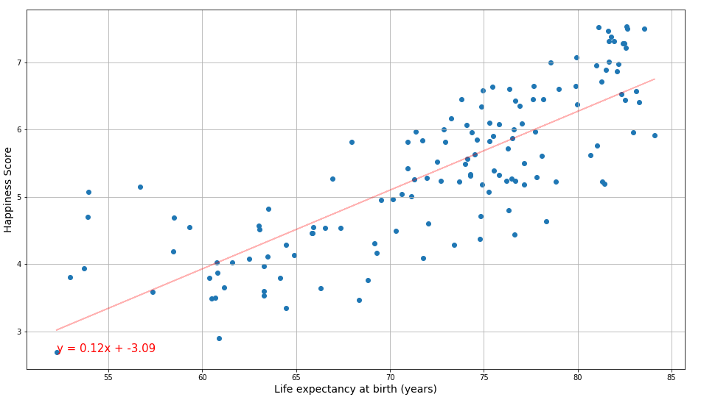
World Happiness Happiness score vs. Life Expectancy
The r-squared is: 0.805
Happiness Score
Vs.
Life Expectancy (W.B.)
Source: World Happiness Report –2017 & World Bank World Development Indicators - 2017
Notes:
These plots are very close and there is an almost identical persons value for both

Slide 10
World Happiness
The Happiness rankings do in fact seem consistent with the data from the same year in the World Bank Report.
So how do some of the other economic indicators look on a “Happiness Scale”?

Slide 11
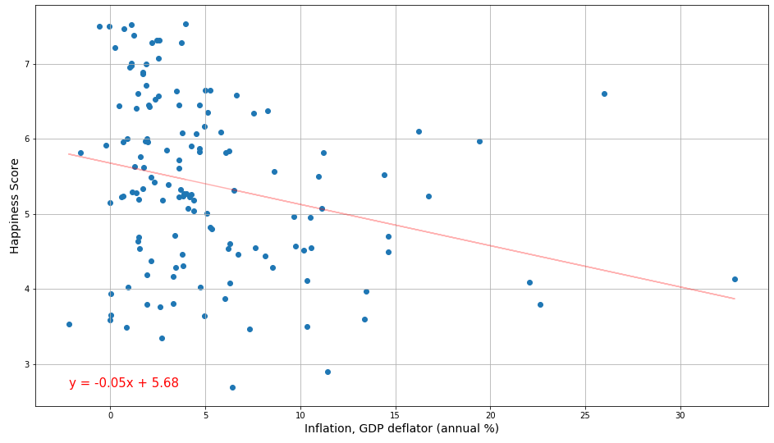
World Happiness Happiness score vs. Inflation
The r-squared is: -0.258
Happiness Score
Vs.
Inflation
(W.B.)
Source: World Happiness Report –2017 & World Bank World Development Indicators - 2017
Notes:
Inflation seems to have an effect on happiness. The countries with the lowest happiness scores have the highest inflation

Slide 12
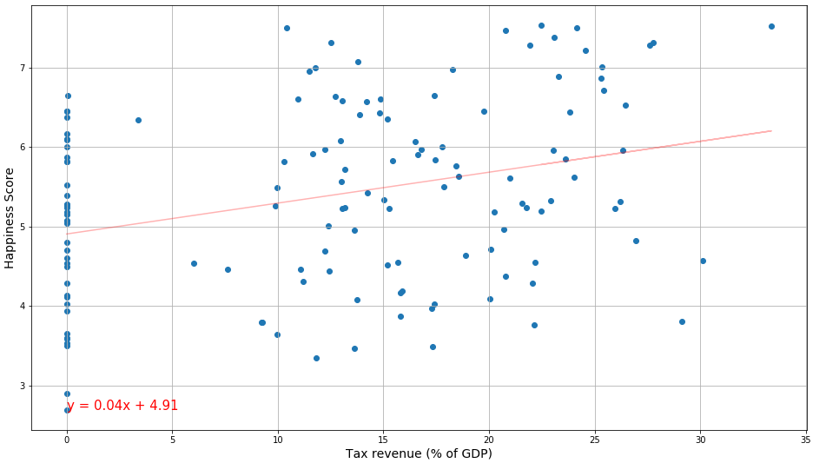
World Happiness Happiness score vs. Tax
The r-squared is: 0.315
Happiness Score
Vs.
Tax Revenue
(W.B.)
Source: World Happiness Report –2017 & World Bank World Development Indicators - 2017
Notes:
Even though inflation has a negative impact on happiness Higher taxes don’t.
It seems Folks don’t mind having fewer dollars, they mind their dollars buying fewer things

Slide 13
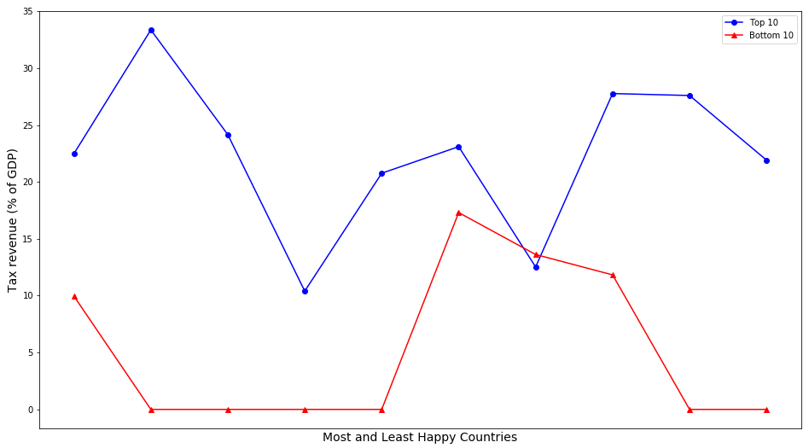
World Happiness Happiness score vs. Tax
Source: World Happiness Report –2017 & World Bank World Development Indicators - 2017
Notes:
8 of 10 of the happiest countries get over 10% of their GDP from Tax revenue
The bulk of the happiest countries have higher taxes

Slide 14
World Happiness
How about some “social” categories?

Slide 15
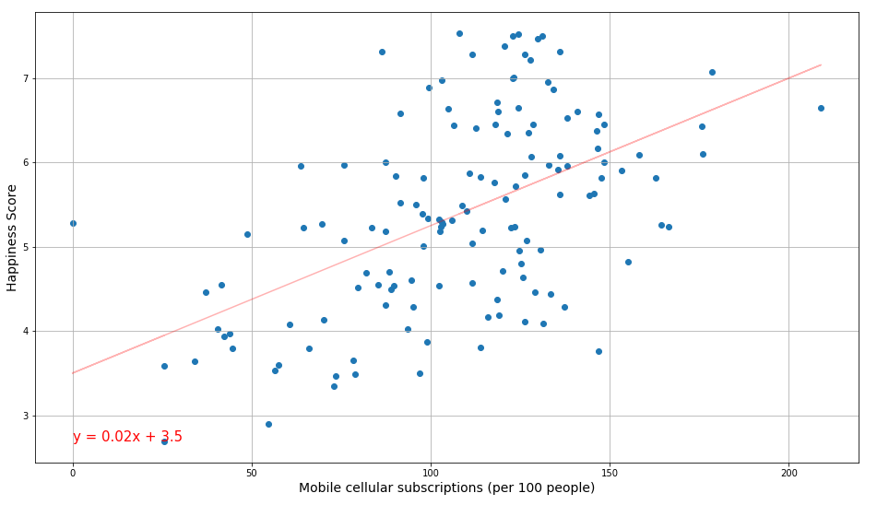
World Happiness Happiness score vs. Mobile cellular subscriptions
The r-squared is: 0.528
Happiness Score
Vs.
Mobile cellular subscriptions (W.B.)
Does your phone make you happy?
Source: World Happiness Report –2017 & World Bank World Development Indicators - 2017
Notes:
Clearly it does, countries with higher subscription rates have higher happiness scores

Slide 16
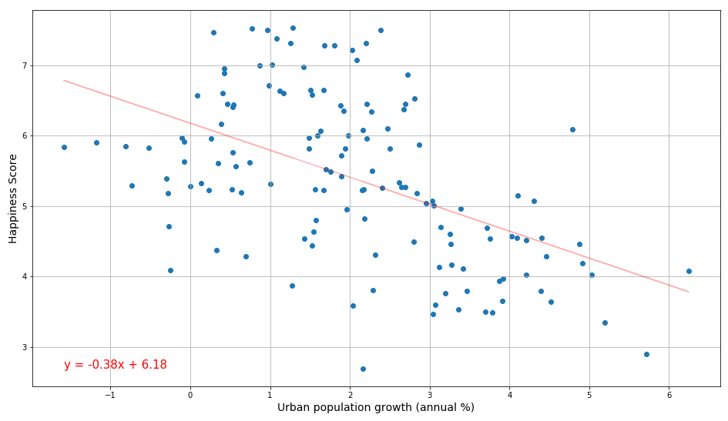
World Happiness Happiness score vs. Urban population growth
The r-squared is: -0.511
Happiness Score
Vs.
Urban population growth
(W.B.)
As cities grow, happiness declines
Source: World Happiness Report –2017 & World Bank World Development Indicators - 2017
Notes:
Pretty strongly too

Slide 17
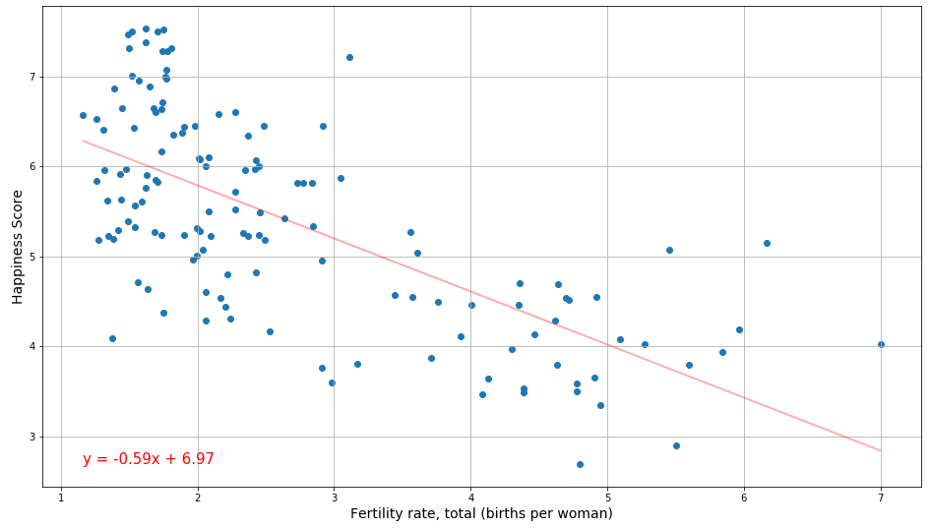
World Happiness Happiness score vs. Fertility rate, total
The r-squared is: -0.680
Happiness Score
Vs.
Fertility rate, total
(W.B.)
I would have been happy if it wasn't for those damn kids!
Source: World Happiness Report –2017 & World Bank World Development Indicators - 2017
Notes:
Damn kids

Slide 18
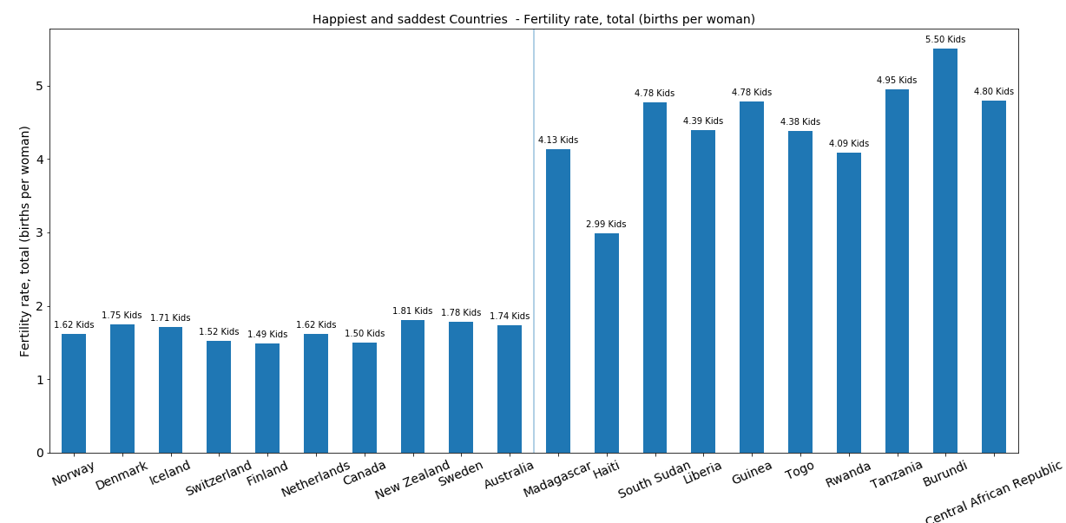
World Happiness Happiness score vs. Fertility rate, total
Source: World Happiness Report –2017 & World Bank World Development Indicators - 2017
Notes:
The happiest countries are having less than two kids per women

Slide 19
World Happiness
Conclusions:
Data from the Happiness Report does correlate with the information from the World Bank.
A deeper look at the more than 17,000 questions in the World Data bank could either inform the WHY of a countries happiness or create a more informed or accurate index.

Slide 20
Thank You
If you are happy and you know it you may clap your hands

Slide 21
Hubris!
Areas where I wanted the project to go but was unable to do so:
1) Randomly pull World Bank information from the API for comparison to the World Happiness data. I was unable to get the API to work. Richard helped me create the below, but by the time we figured it out I was out of time to build the loop and had moved on to pulling the CSV data.
2) Going through the World Bank data there were many questions that were interesting but did not contain full data for every country. I wound up having to choose questions that had enough data.
3) My initial idea was to try and create a new happiness index using the information from the World Bank. I wanted to create the same scores that the happiness index uses but with significantly more information; especially including social, environmental, and attitudinal data. Wow did that not happen!
4) I created a map with the Lat/Lug of the Top 10/Bottom 10 but in the end deleted it because I felt like it really wasn't adding anything to the report. Top 10 are mostly in Europe and bottom ten are mostly in Africa. I wanted some mapping component but didn’t make it work.
What I’ve presented is what was left after trying and failing to create a much more ambitious project.
Frankly I should have asked for more help and sooner

Slide 22
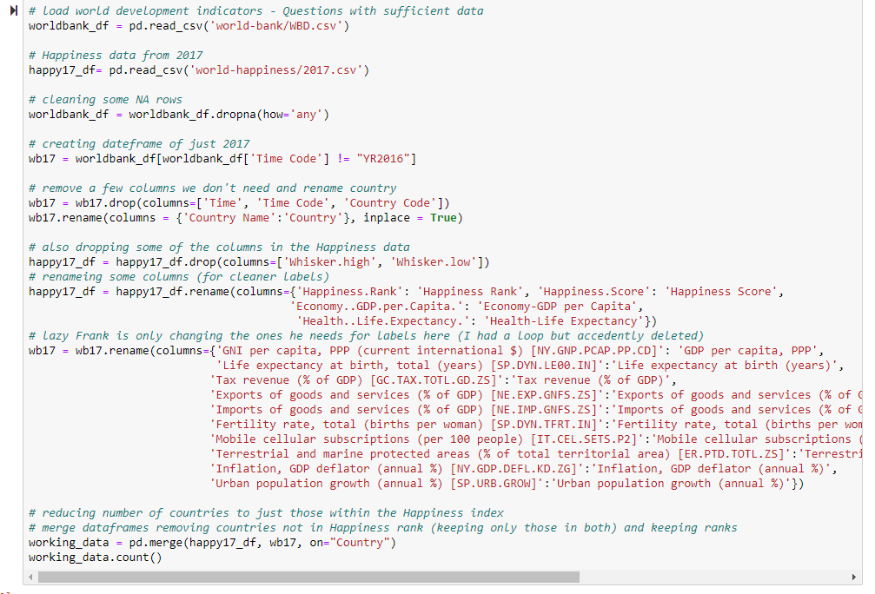
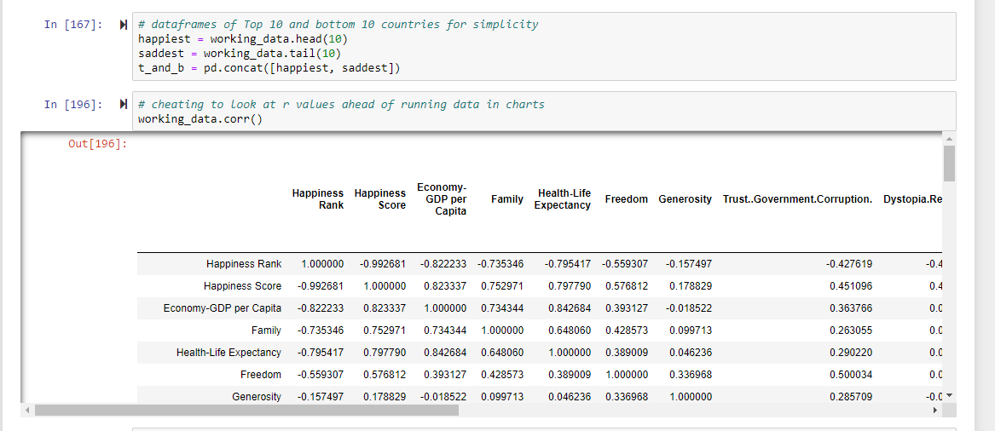
Loading, cleaning, and combining the data. I used 2 CSV’s cleaned them and combined on “Country”
I also created DataFrames for the Top 10 and Bottom Ten Countries so I could check and graph.
The bottom table shows the correlation information so I could choose interesting ones (cheat).

Slide 23
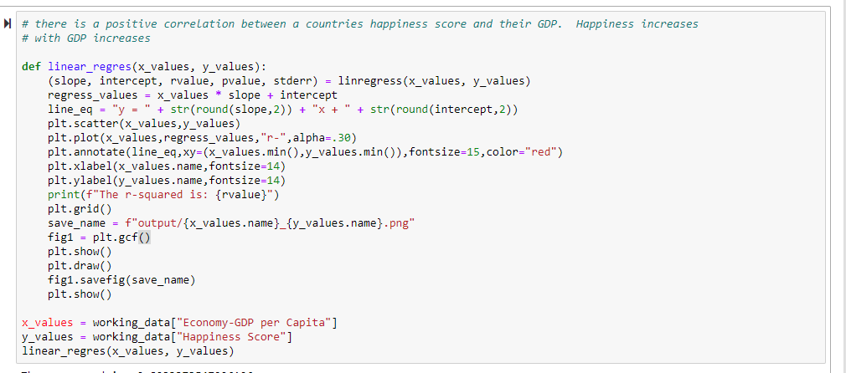
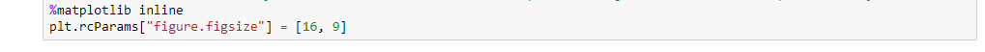
The function from my Pandas-API Homework that I used to create the linear regressions
This little bit of code at the top of my jupyter notebook controlled the size of all charts in the notebook. I thought it was neat

Slide 24
What Else?
It isn’t really about having more time…
If I was working with someone (or smarter) I think I could have come closer to creating a happiness index (in some way) from the World Bank data.
Potentially this would have been less economy based and included more social and cultural information
I would have like to do something with the mapping
Originally I called this report “Money can buy you happiness and poor can’t buy $#*!”. I had hopped to look deeper at poorer countries.

